Slide 1
Tableau Mini-Projects
Lesson 18.3
Notes:
1.1

Slide 2
Class Objectives
By the end of this lesson, you will be able to:
Perform exploratory data analysis using Tableau.
Clean data before creating visualizations.
Create Tableau dashboards.
Present a Tableau Mini-Project

Slide 3
Activity: Global Superstore Warm-Up
In this activity, you will work with sales from a fictitious company to find insights through visualization.
20 Minutes
Notes:
2.2

Slide 4

Activity: Global Superstore Warm-Up
Instructions:
Explore the data by creating visualizations of your choosing.
Focus on data exploration rather than obtaining predefined visualizations.
You are encouraged to come up with interesting and creative visualizations, and you are free to bring additional data sources into the workbook.
Bonus:
If you finish early, try combining your visualizations into a dashboard!
Hint:
Don’t forget to save to Tableau Public once finished.
Notes:
2.2

Slide 5
Notes:
2.3

Slide 6
Activity: Airline Safety
In this activity, you will explore the safety of the world's airlines.
15 Minutes
Notes:
2.2

Slide 7
Activity: Airline Safety
Instructions:
Perform an open-ended exploration of the data. some questions to consider include:
What are the safest airlines in the world, and how do we define the idea of safety?
Can we group airlines by region to determine whether some regions have better track records than others? What are the potential fallacies of this approach?
Bonus:
If you finish early, try combining your visualizations into a dashboard!
Hint:
Don’t forget to save to Tableau Public once finished.
Notes:
2.2

Slide 8
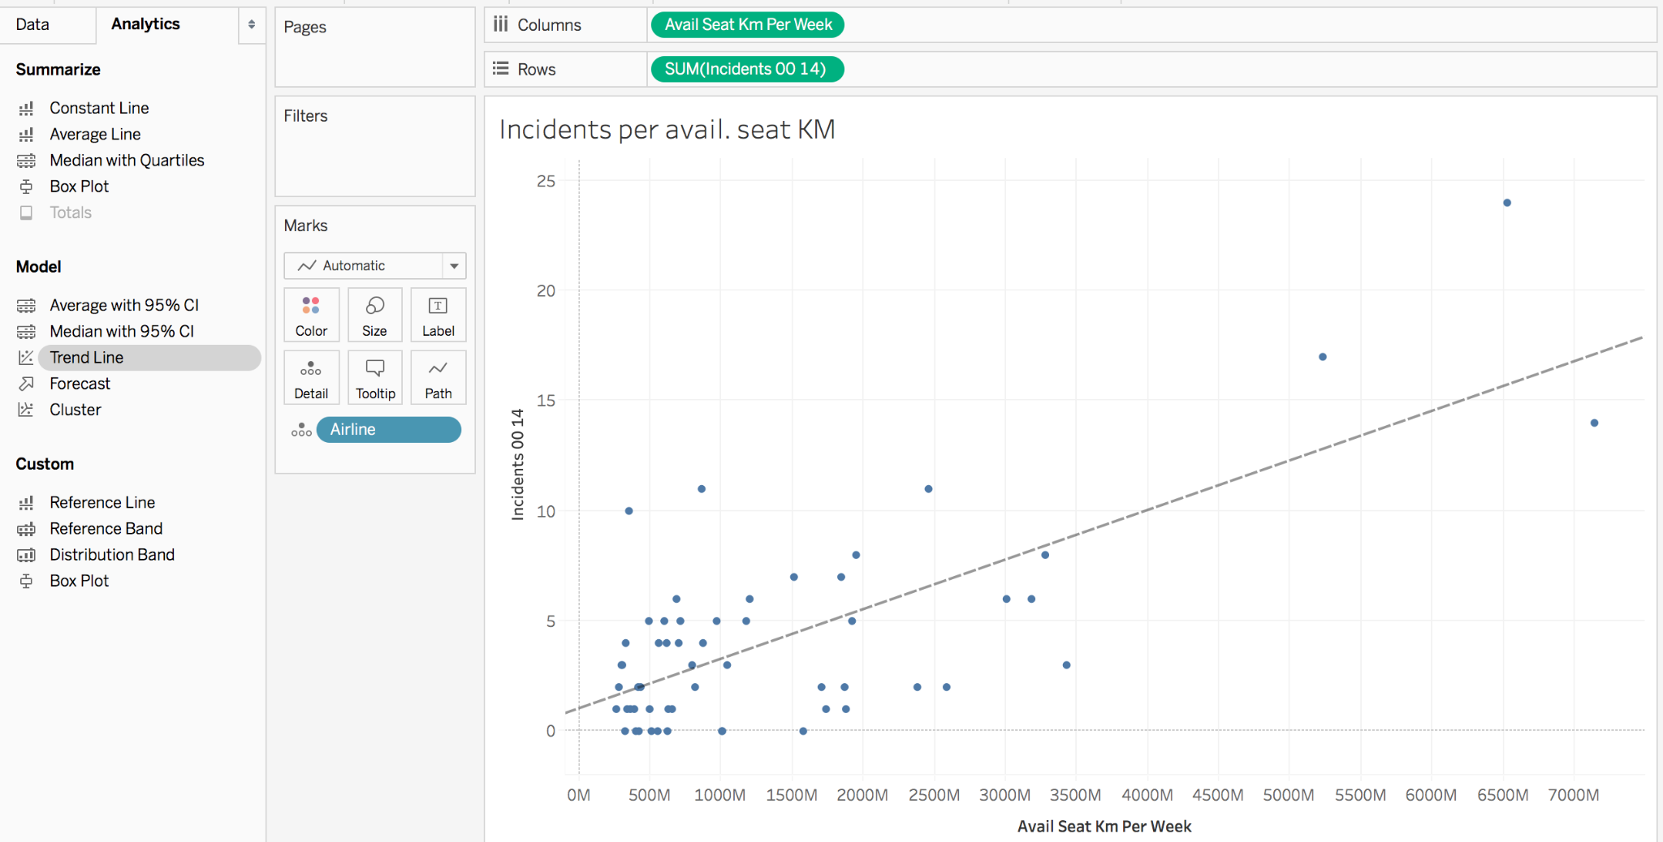
Activity: Airline Safety
Ex: A scatter plot of the number of incidents per seat km across all airlines
Notes:
2.2

Slide 9
Notes:
2.3

Slide 10

Notes:
-------------------
Image source: AdobeStock_56885471

Slide 11
Activity: Popular Baby Names
In this activity, you’ll create visualizations using data on popular baby names and surnames, along with demographics and popular name-surname combinations.
20 Minutes
Notes:
3.2

Slide 12
Activity: Popular Baby Names
Instructions:
Create several visualizations of names and their popularity, including the following:
The most popular baby names during the period from 2000 through 2017
The popularity of surnames and the proportion of Hispanic individuals with this surname
Create a visualization for the provided popular name combinations.
Create more specific visualizations:
For example, you could study how the popularity of your name, or someone you know, has changed over the years.
Hint:
Don’t forget to save to Tableau Public once finished.
Notes:
3.2

Slide 13
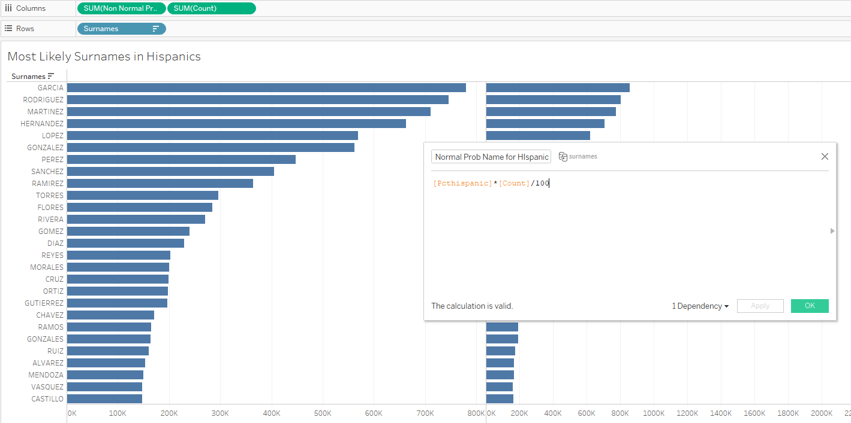
Activity: Popular Baby Names
Ex: The most likely names for a Hispanic subject
Notes:
2.2

Slide 14
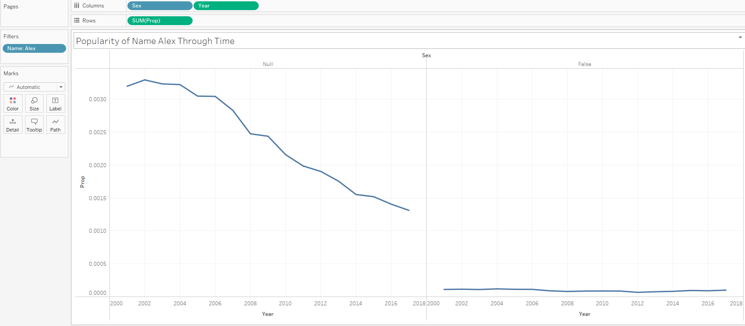
Activity: Popular Baby Names
Ex: How name popularity has evolved over the years
Notes:
2.2

Slide 15
Notes:
3.3

Slide 16
Activity: Mini-Project
In this mini-project, you will use your Tableau skills to explore data and create visualizations. After, you will give a brief (3 to 5 minutes) presentation with a summary of your visualizations and findings.
55 Minutes
Notes:
3.2

Slide 17
Activity: Mini-Project
Instructions:
In this mini-project, you will use your Tableau skills to explore data and create visualizations.
You will work in pairs or groups of three.
It is preferred to use at least two data sources.
You can use your previous group projects for inspiration; however, you should not simply replicate your old projects in Tableau.
When working with data, you may need to clean it with a tool like Pandas before bringing it into Tableau.
You will give a brief (3 to 5 minutes) presentation with a summary of their visualizations and findings.
Hint:
Don’t forget to save to Tableau Public once finished.
Notes:
3.2

Slide 18
Notes:
3.3

